Slide 1


Agile Presentation By: Afahri Kerr

Slide 2


Slide 3
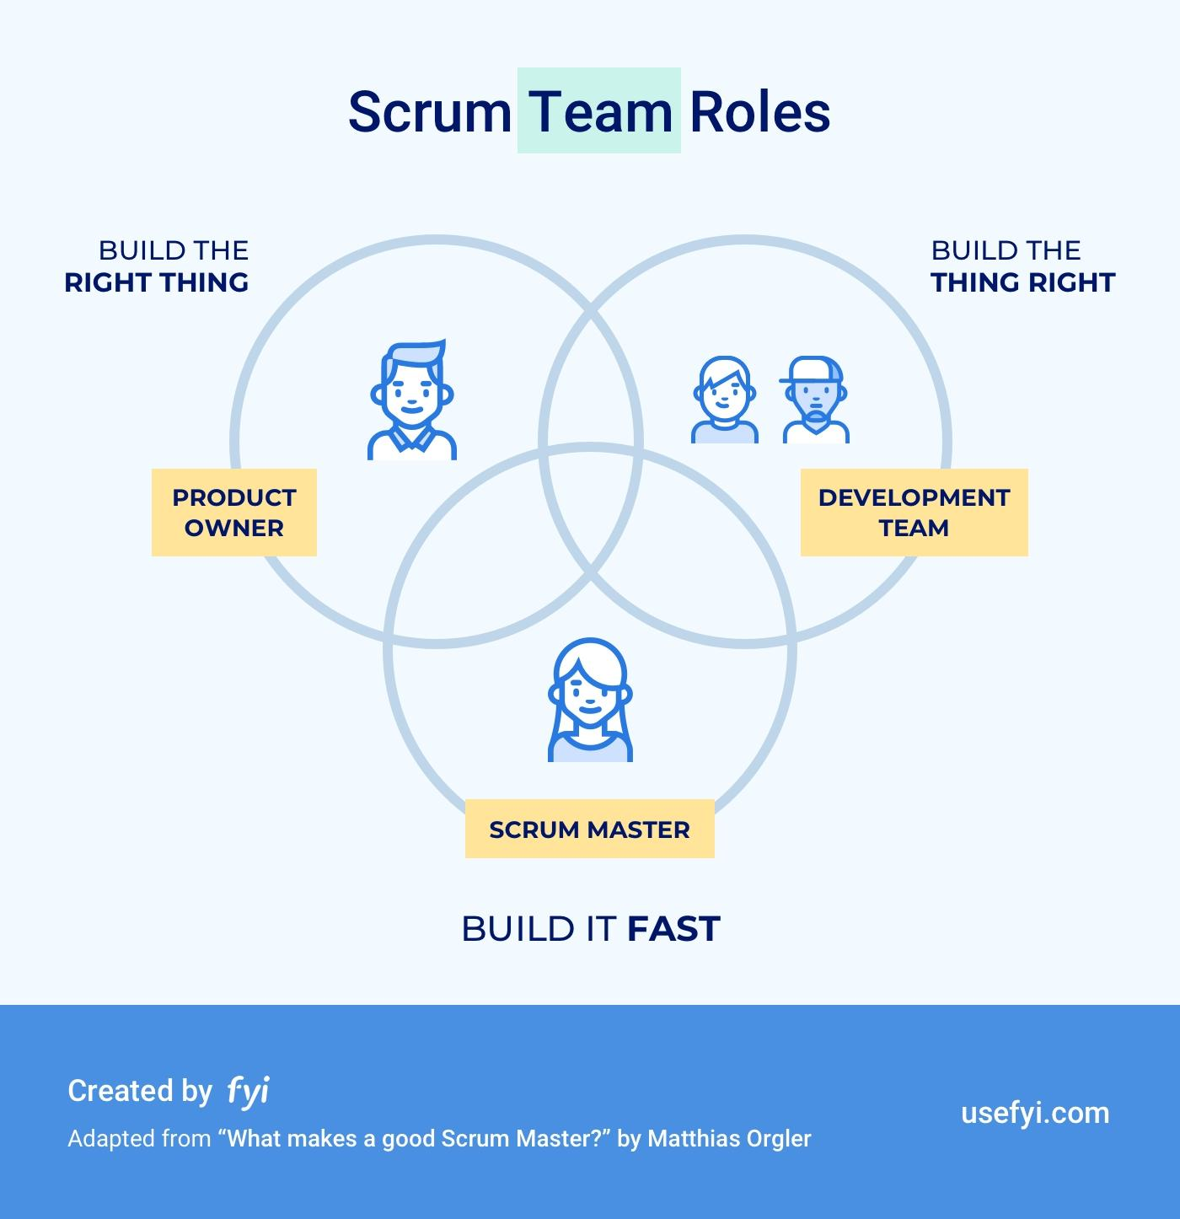

Slide 4
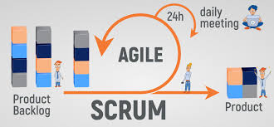

Slide 5
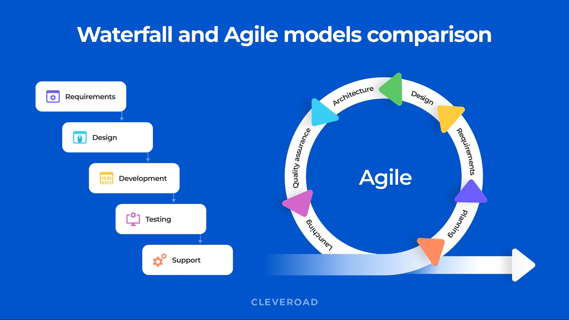

Slide 6


Slide 7
Reference: Charles G. Cobb. (2015). The Project Manager’s Guide to Mastering Agile : Principles and Practices for an Adaptive Approach. Wiley.

